Slide 1
UMass Lowell Computer Science 91.404
Analysis of Algorithms
Prof. Karen Daniels
Spring, 2008
Text: Chapter 3
Growth of Functions

Slide 2
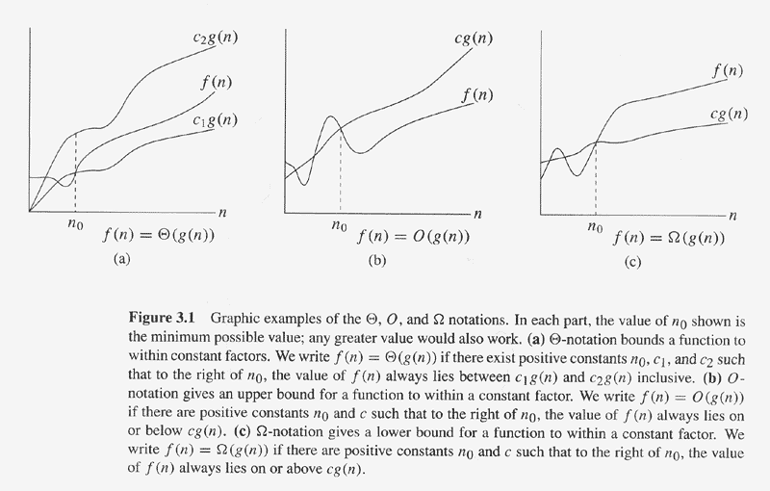
Copyright © The McGraw-Hill Companies, Inc. Permission required for reproduction or display.
Asymptotic Analysis
Source: Textbook [Cormen2001]

Slide 3
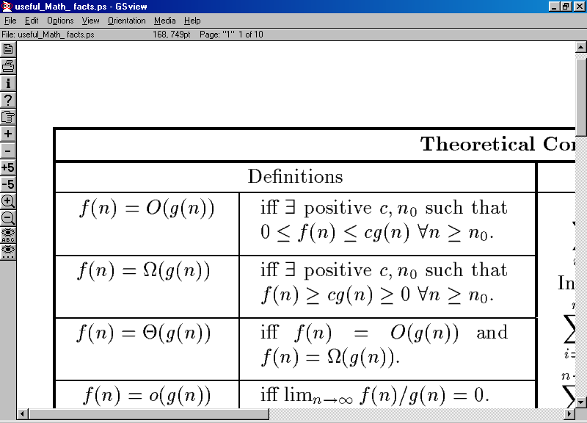
Asymptotic Analysis
Math fact sheet (courtesy of Prof. Costello) is on our web site.

Slide 4
Function Order of Growth
1
lglg(n)
lg(n)
n
n lg(n)
n lg²(n)
n²
n⁵
2^{n}
know how to order functions asymptotically
(behavior as n becomes large)
O( ) upper bound
Ω( ) lower bound
Θ( ) upper & lower bound
know how to use asymptotic complexity notation
to describe time or space complexity

